Slide 1
mmWave Radar with Camera module Integration
To be presented by :
Shreekant Kodukula
Abhishek Sharma
Vaibhav Srivastava

Slide 2
Introduction
We can implement mmWave communication using a specific type of radar, and the evaluation boards, which are on offer at Texas Instruments, make use of a frequency modulated continuous wave (FMCW) radar. It helps us measure the angle and the velocity. This usually differs from the traditional radars, which transmit pulses periodically and not continuously like the FMCW.
The main RF components of FMCW radar are a synthesizer, mixer, receiving antenna and a transmitting antenna. The radar operates as follows:
The chirp signal is generated with the help of a synthesizer.
• Then it is transmitted by a transmit antenna.
• It gets reflected from the objects, generating a reflected chirp.
• Then it is captured by a receiving antenna.

Slide 3
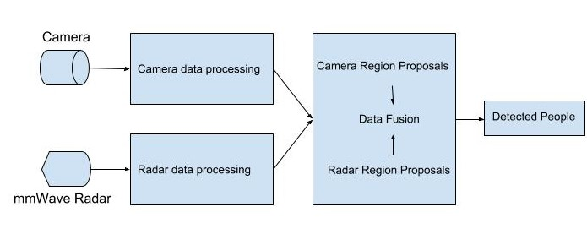
Design for the Integration
Camera data sent to Remote server
Remote Server

Slide 4
Design Specifications
IWR vs AWR Evaluation Boards for mmWave communication: for this type of communication, we can use the evaluation boards provided by Texas Instruments to conduct further tests. But for that we need to choose which type of application we are focussing our research on and what components are needed for it.
There are two types of boards available at Texas instruments, namely IWR, which is for industrial applications and AWR, which is for automotive applications.
The main notable differences between the two types of sensors are:
· AWRxxxx device support wider range of temperature junctions, as compared to IWRxxxx. -40 to 125C as compared to -40 to 105C.
· AWR1642 has two CAN interfaces, where as IWR1642 only has one CAN interface. The second interface on AWR1642 is CAN-FD, which is used for additional memory and faster data rates.

Slide 5
Design Specifications
Design specifications of IWR1642: The evaluation board consists of various sub systems like transmit sub subsystem, DSP subsystem, which has a digital signal processor C674x, Microcontroller subsystem, which has a microcontroller Arm Cortex-R4F.
The DSP subsystem usually is used to perform operations like FFT. MSS subsystem is used to send messages to other subsystems in order to schedule tasks and perform operations. In IWR1642, there are a total of 2 transmitting antennas and 4 receiving antennas.

Slide 6
Range Measurement
Range measurement: In FMCW radar, the range is measured with the help of a chirp signal. Chirp signal is a signal, whose frequency increases linearly with time. As we can see from figure 1, the frequency increases with time. FMCW radar uses these kinds of signals and then the reflections from objects, when chirp signals are transmitted are utilized in localizing an object.
For two sinusoidal inputs x1 and x2, where, x1 = sin(w1t + φ1) and x2 = sin(w2t + φ2), the output xout has an instantaneous frequency equal to the difference of these two signals.

Slide 7
Range Resolution
The ability of a radar to disinguish between two different objects is called as the range resolution of a radar. But whenever two objects move closer towards the radar, it cannot detect both of those objects as two different ones. This problem can be solved by increasing the length of the IF signal. It has some consequences though, since the increase in the IF signal will result in increase in the bandwidth as well, and the spectrum will have two different peaks. This concept is stated by the Fourier Transform Theory. The phase change is usually due to the differential change in distance. The phase change can be derived using the equation 1: . Thus the angle of arrival can be computed with the help of with the help of this equation 2: .

Slide 8
Maximum angular field of view and velocity measurement
It is usually the maximum Angle of arrival, that a radar can measure. The maximum unambiguous range of angle requires the < 180. This corresponds to the equation . The maximum field of view for two antennas placed length, l apart is: . So the maximum field of view can be achieved with an angle of 90 degrees.
The measurement of velocity by an FMCW radar is done by transmitting two chirps separated by a T_{c} (inter-chirp duration). The range FFT of both the chirps is calculated. The phase difference in the Range-FFT of the chirps is utilized to calculate the velocity of the object as follows:
ΔФ = 4пνT_{c}/λ
Hence ν = ΔФ λ / (4пT_{c})
ν(max) = λ/4T_{c}

Slide 9
People Counting
Processing Chain
In IWR1642 programming, there is a processing chain, in order for all the components to work accordingly with each other.
• Front end: it represents all the antenna and RF transceiver responsible for the implementation of FMCW radar.
• ADC: The ADC output samples are buffered in ADC output buffers for access by the digital part of the processing chain.
• EDMA controller: Its usually user programmed. The main purpose DMA is to move data from one memory location to another without using a secondary processor.
• C674 DSP: This is the digital signal-processing core that implements the configuration of the front end and executes the main signal processing operations on the data. This core has access to several memory resources as noted further in the design description.
• ARM R4F: This ARM MCU can execute application code including further signal processing operations and other higher-level functions. In this application the ARM R4F primarily relays visualization data to the UART interface. There is a shared memory visible to both the DSP and the R4F.

Slide 10
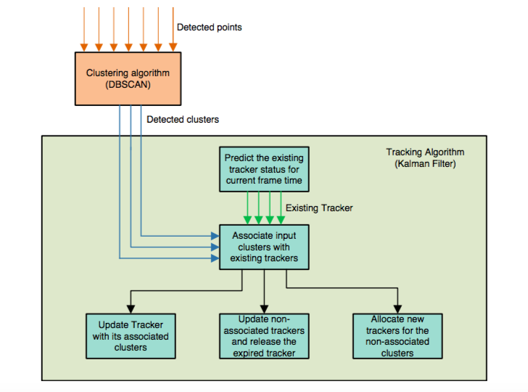
Signal processing chain in DSP (People Counting)

Slide 11
Signal processing chain in DSP (People Counting)
The implementation of the traffic monitoring example in the signal-processing chain consists of the following blocks implemented as DSP code executing on the C674x core in the IWR1642:
Clustering: Detected points are accumulated over four frames. Every fourth frame DBSCAN, a point density based clustering algorithm, is run. The clustering operation designates one or more subsets of the accumulated target points. Each of these subsets is interpreted as containing points belonging to the same object such as a vehicle. Other points not meeting the clustering criteria are left unassociated. This output data is stored in the L2 memory.

Slide 12
Signal processing chain in DSP (People Counting)
· Tracking: The output of clustering is fed to a basic tracking algorithm, which also updates every fourth frame. The basic tracking algorithm maintains state information for one or more tracked objects. The update operations consist of cluster association, track management, and Kalman filter based tracking of objects. During the update process, tracks may be created or deleted, and existing tracks are updated to include estimated object position, velocity, and other attributes.

Slide 13
Clustering algorithm (detailed)
The clustering algorithm is used to separate the points based on whether they are closer in both space and speed. The distance metric is computed between the target point a and all other candidates. This distance metric is then compared with the adjusted distance threshold Epsilon to decide whether candidate b is qualified to join the a-group.
|a_{loc} –b_{loc}| 2 +weight ́|a_{vel}– b_{vel}| 2 <Epsilon + weight ́ x min(a | vel |,vFactor)^{^2}
Epsilon: The maximum space distance to be included in the cluster group
Weight: The weight between the space distance and speed differences in the distance matrix.
minPoints: Minimum Points in the group to claim a cluster.
vFactor: maximum speed which is to be added to the epilson.

Slide 14
Tracking algorithm (detailed)
The clustering outputs are detected by the Kalman filter, and appear amongst different frames. The location and velocity of points X and Y are tracked through the Kalman filter. The input to the Kalman filter is the clustering algorithm. One important consideration for this filter implementation is the distance metric, between the clusters and existing trackers. The candidate closest to a particular cluster will be associated to that cluster. As long as the cluster center falls within the trackers range, it will be associated. The distance between both of them should satisfy this condition:
|LOC_{tracker} – LOC_{cluster}|² < (trackerAssociationThreshold² + 4 ́ x xSize ²_{tracker} + 4 ́ x YSize² _{tracker} )
If there arises a case that multiple clusters are associated with the same tracker, the combined cluster will be computed and used to update the tracker. The tracker without any association at this time will be updated on their status and has a potential risk to be expired. The cluster without any association will have a new tracker allocated. The expired tracker will be collected and reused later during new tracker allocation

Slide 15
Design for the Integration
Camera data sent to Remote server
Remote Server

Slide 16
SYSTEM
Raspberry pi, Camera and Processing Remote Server
We use a Embedded Camera which uses camera serial interface to send the data. As we want to send 640X480 RGB images over the network in real time for processing so we cannot use low end micro-processors.
Raspberry pi 3 to capture the images. It supports a system call to talk to embedded camera.
We did try couple of other approaches to send the data. 1. Send raw data using socket programming. - Result - Only 2 FPS. 2. Send data using HTTP protocol - Result - 20 FPS. 3. Send data using RTSP protocol - Result - 25 FPS.
On the remote server we use Opencv to capture the Network Stream.

Slide 17
People Detection using Deep Learning YOLO
Once we get the frames which are of the size 640x480 we scale them to size 416x416. The deep learning model we are using is call You Only Look Once or aka YOLO. It’s the state of the art object detection algorithm.
YOLO Algorithm -
Divide the image into SxS grids.
Pass through 6 Convolutional and 6 Max Pooling layers.
Use 1x1 Convolutions (Equivalent to FeedForward layers) on the features detected by the previous layers.
1x1 Convolutions will give probabilities associated to the region in the image.
Do classification of the region based on the probabilities.

Slide 18
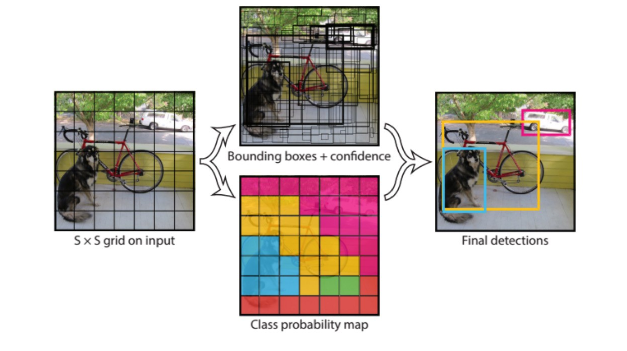
Continued ...
Taken from Yolo Homepage

Slide 19
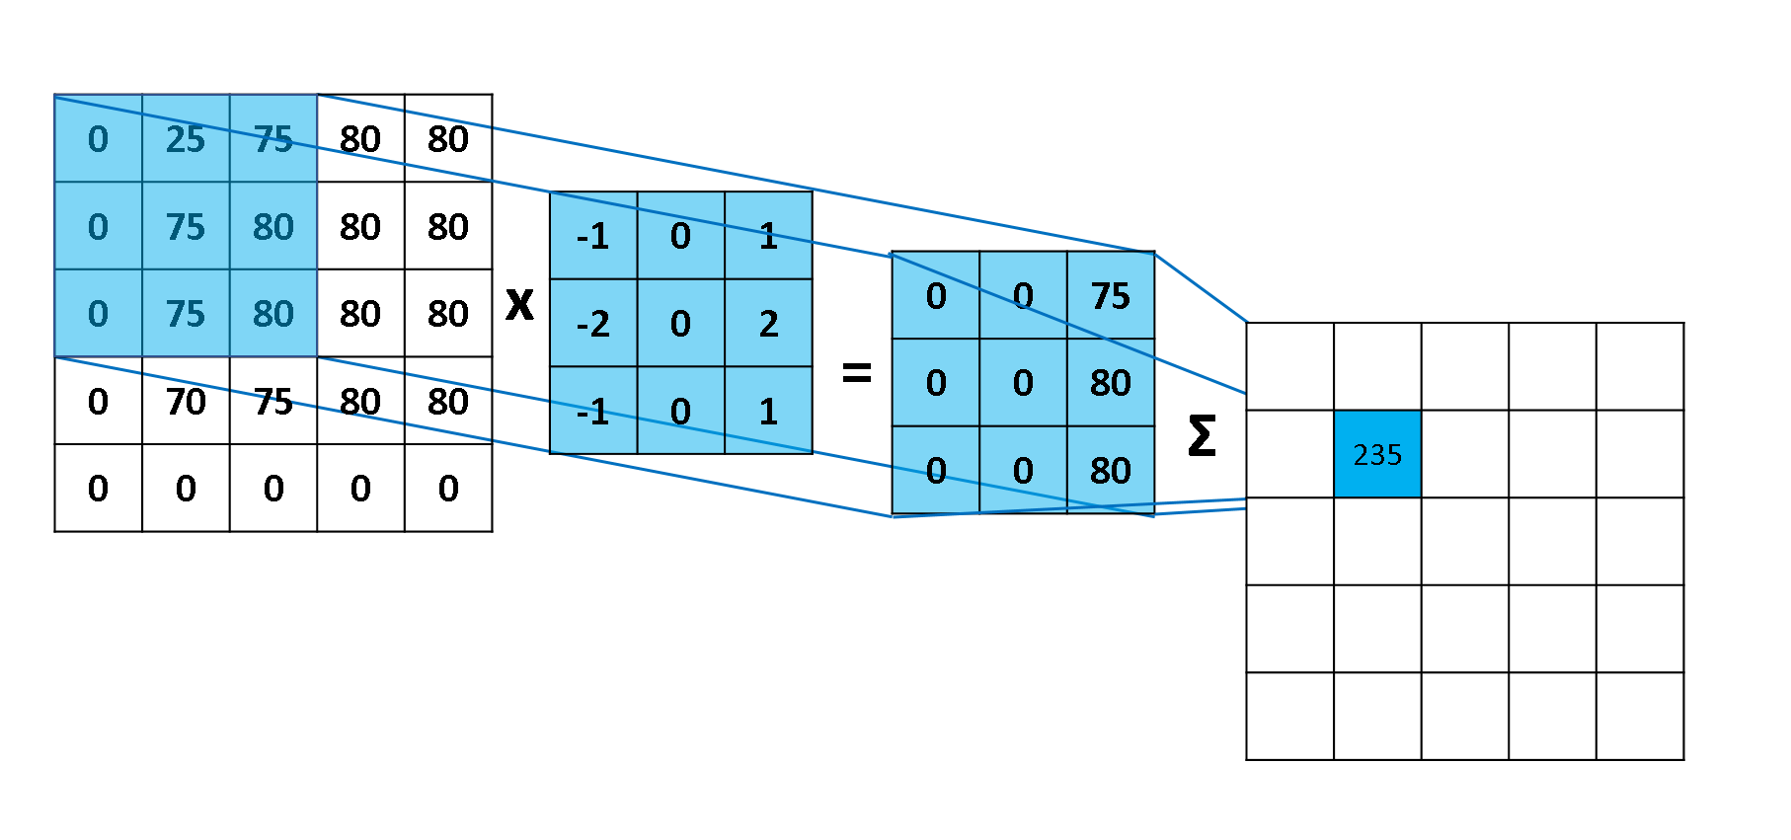
Convolution Layers
Every Convolution layer has convolution kernels or filters which are responsible for picking out visual features. The simplest way to understand these filters is looking at edge detection filter i.e Sobel kernel which can detect edges.
YOLO has more than 752 filters of different different sizes to capture different features.

Slide 20
Convolution Layers
This is the same thing which we saw in the earlier slide but this time we are rolling through the whole image. In this way we can capture the edges on the whole image.
Now we can use these kind of visual features to classify different different objects by just using classification neural network. Taken from -https://mlnotebook.github.io/post/CNN1/

Slide 21
Tensorflow Library
The original Yolo Model is implemented in their own custom framework so I use Tensorflow Library to replicate the YOLO Model.
Using the pretrained weights I fine tuned the model for our purpose using the pedestrian dataset from KITTI dataset.
Once I get regions and their probabilities I use Non-Max Suppression algorithm to suppress noisy detections.
After getting the regions I get the data from Radar and start the senor Fusion.

Slide 22
Sensor Fusion Projection and Data Fusion
Radar data is received by the processing remote server by using TCP sockets.
I project the Radar data points from radar frame of reference to Image frame.
We use Hungarian algorithm so solve the linear assignment problem between camera points and radar points. Once we get One to one correspondence between the camera and radar points we refine the points if the distance is greater than a threshold.
Once we have completed the points mapping, we associate the depth which we get from radar to the detection in the image.

Slide 23
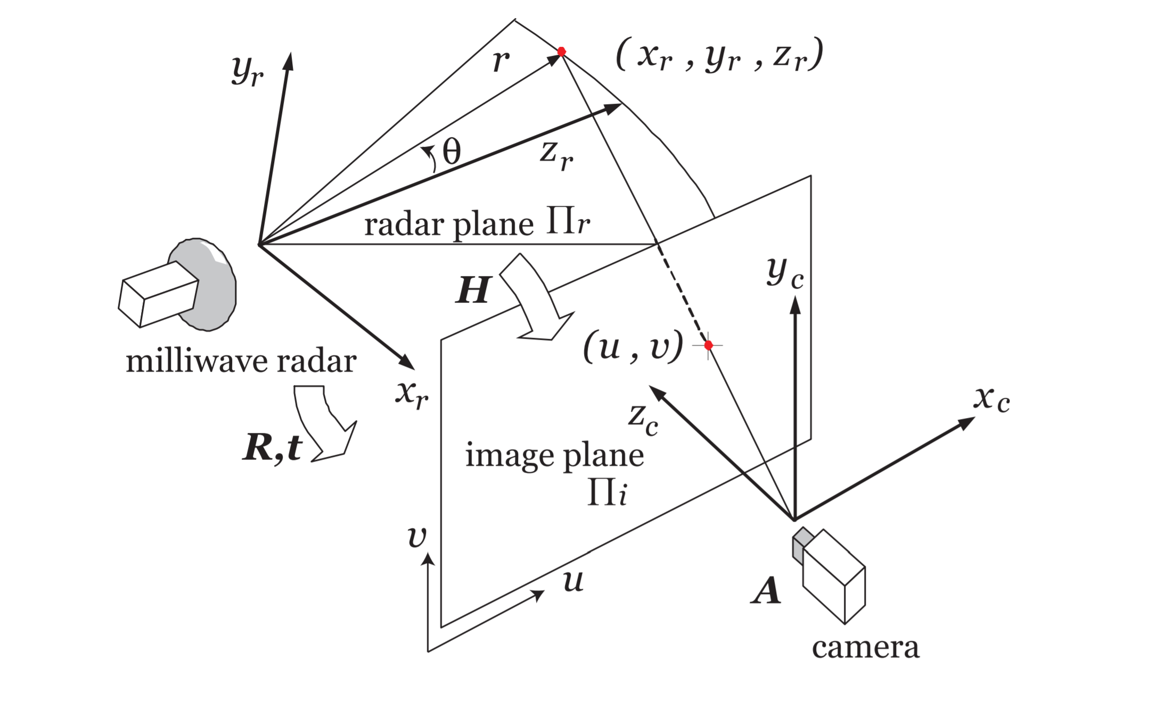
Sensor Fusion Camera Radar Calibration
To fuse the data first bring the data to common frame of reference.
[u v 1]T= H [Xr Zr 1]T
Where H is a 3x3 Matrix .
Use Linear Least square method to solve for H. Performed by the whole group.

Slide 24
Problems and Results -
Problems -
Sequential code execution problem causing frame misses. Solved using multithreading.
Radar Frame and Camera frame time synchronization. Not solved yet.
Results -
Camera - people detection works at 12 FPS on GTX 940 MX which has only 5.1 compute power. When we use a more higher end GPU we will be able to get higher frame rates.
After the data projection and fusion the frame rate degrades to 10 FPS and also we miss a lot of detections. The reason is that Radar Frames are not synchronized.

Slide 25
THANk YOU

